Slide 1
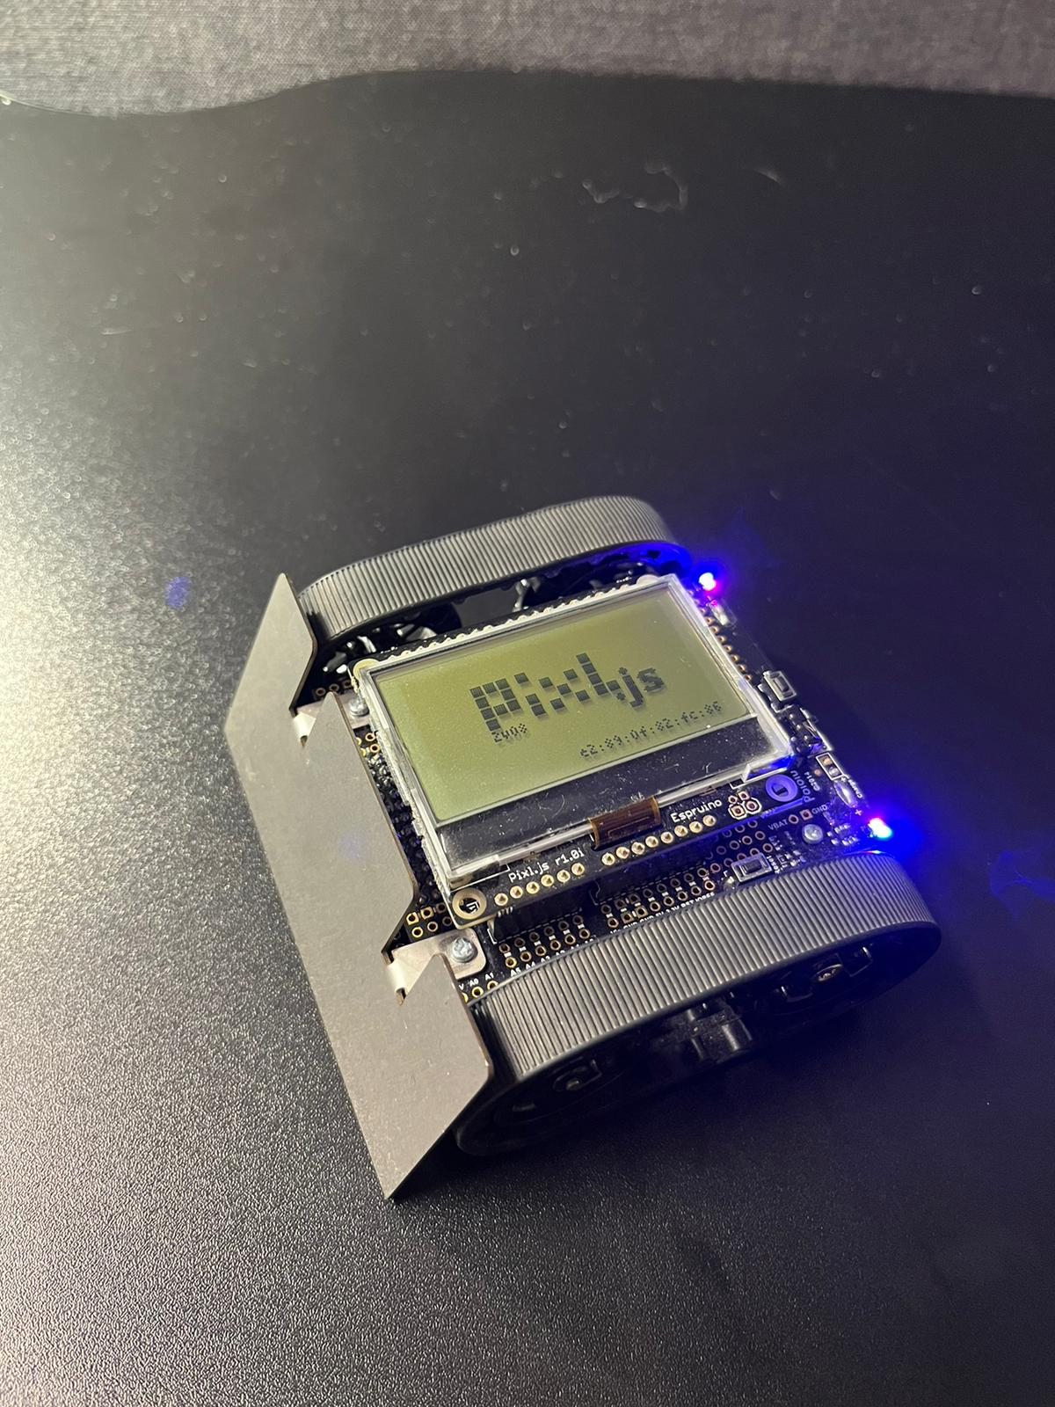
Virtual Lead: A Competition and Web-Based Smartphone Controller for a Self-Driving Robot
Lewis Trundle (2469635T)
Supervised by Jonathan Grizou

Slide 2
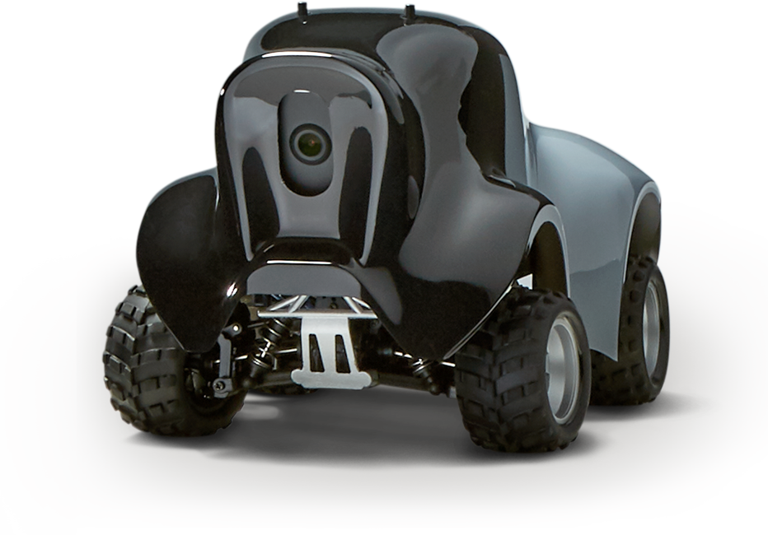
Motivation
Self-driving robot competitions are a great way to learn and develop new skills, while collaborating with other people.
Most competitions are not affordable – requiring expensive robots.
The same self-driving techniques are used – need more variation and exploration into new approaches.
AWS DeepRacer car – costing $399

Slide 3
Competition
Intended Products
Controller
Controller

Slide 4
Aims
Competition
Controller
Affordable
Accessible
Collaborative
Versatile
Promote affordable solutions
Be accessible to use
Provides precise and responsive manual control
Presents a novel self-driving approach

Slide 5
The Competition: Website Demonstration

Slide 6
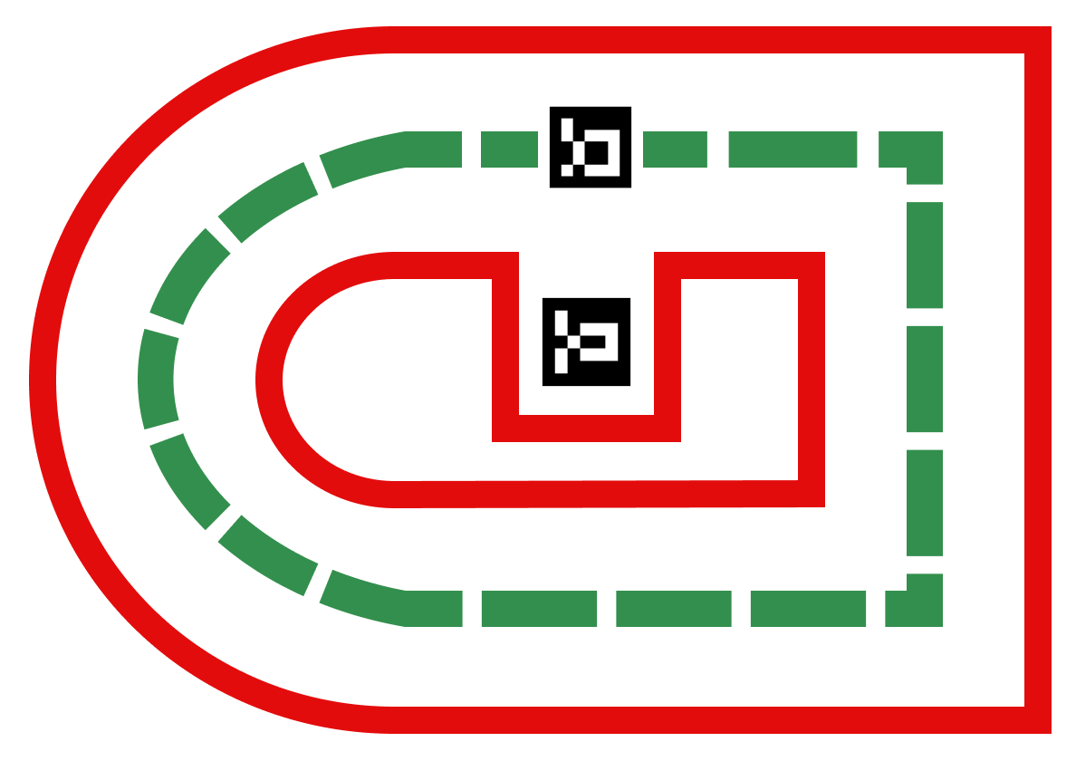

Slide 7
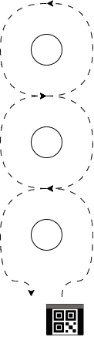
The Simplified Competition
3 Stages
Navigating around an object and back using the manual control.
Navigating through a slalom and back using the manual control.
Navigating through a slalom and back using the autonomous control.

Slide 8
The Controller

Slide 9
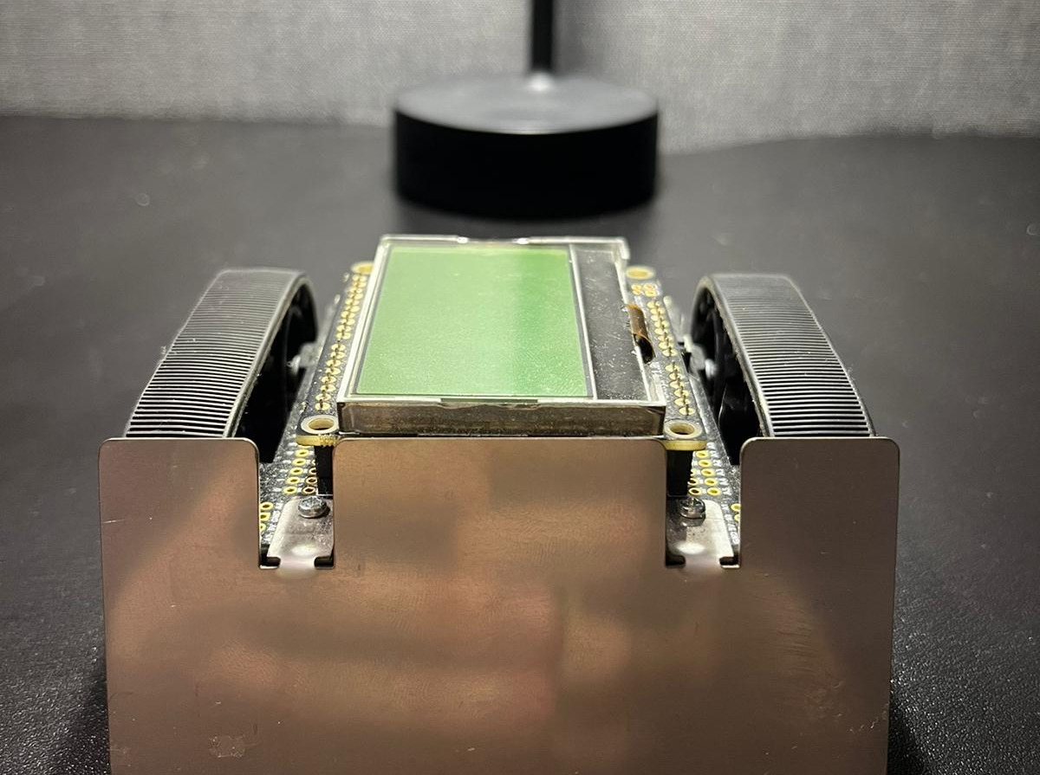
Restrictions
Web browser based
Must work with the Zumo Robot for Arduino with attached Espruino Pixl.js.
Must integrate smartphone technology and work with Android OS

Slide 10
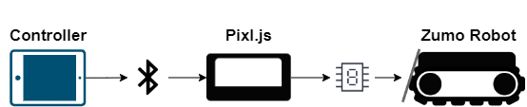
Communication
Web Bluetooth to connect from Web Browser to Pixl.js
Pixl.js uses serial communication to activate functions of the robot.
A UART connection is established to communicate.

Slide 11
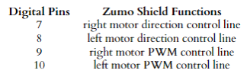
Controllable Attributes
Don’t use sensors on robot. Instead, we control the robot’s:
- Motor speed
- Motor direction
Motors can be changed individually.
Upload code to the robot

Slide 12
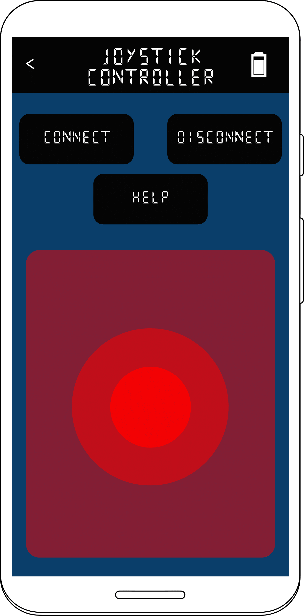
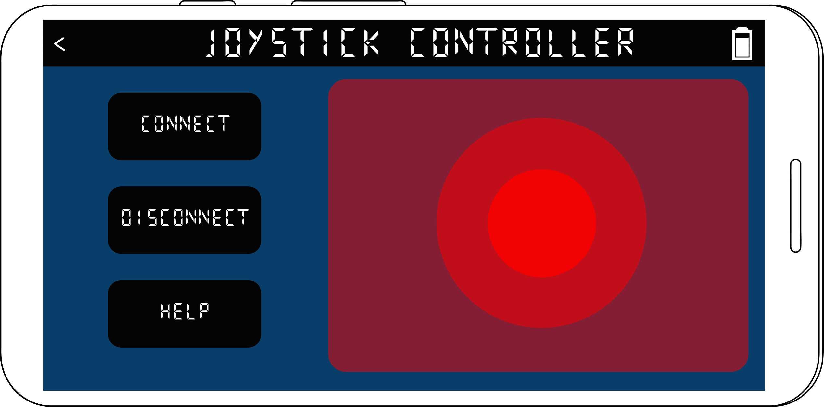
Manual Control: The Joystick
encompasses both uni-directional movement and turns
high degree of precision
simulate the feeling of game station controller

Slide 13
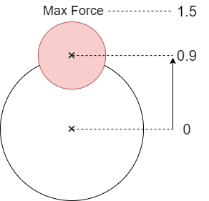
Force of the Joystick Pull
Force of the joystick is determined by distance from the center.
The force of a pull is then calculated as a ratio of the maximum defined force.
This is used to scale the motor speeds of the robot
0.9/1.5 = 0.6 = 60%

Slide 14
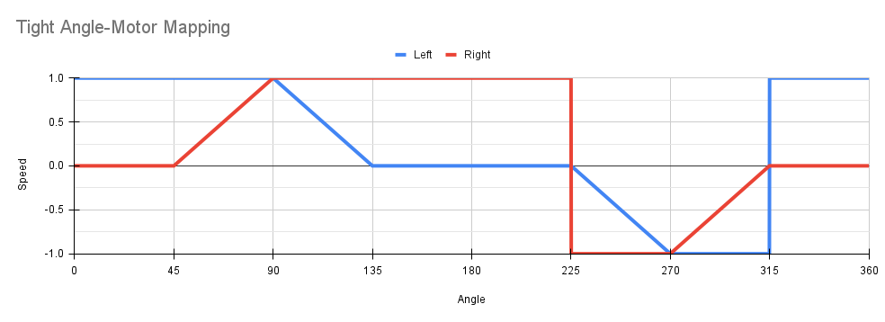
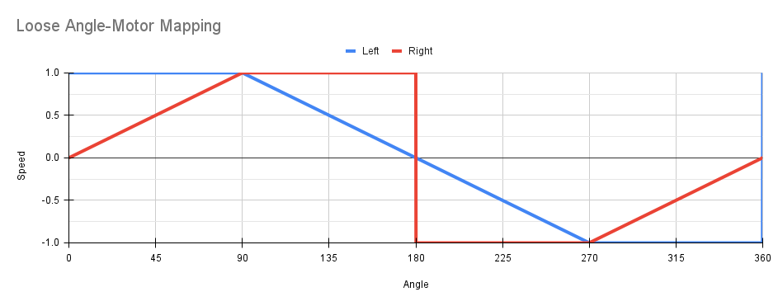
Translating Angles to Motor Speeds
Angle-motor mapping translates an angle to move at into speeds for the left and right motor.
The mapping is a piecewise linear function.
Motor speeds are defined at specific angles.
Tight mapping causes robot to turn faster (opposed to the loose mapping).

Slide 15
Joystick Demonstration

Slide 16
Adjustable Settings

Slide 17
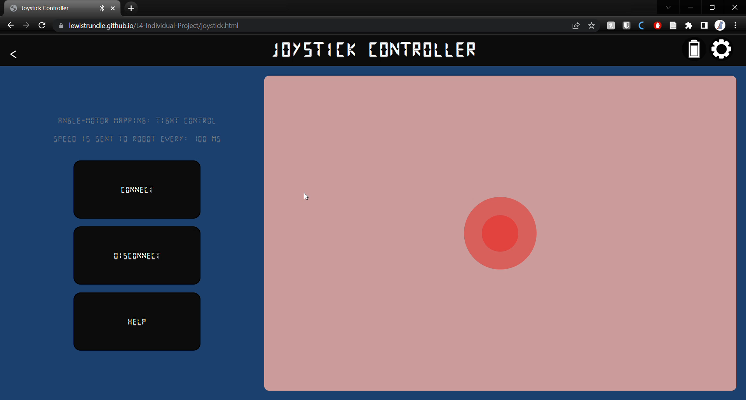
Check Battery

Slide 18
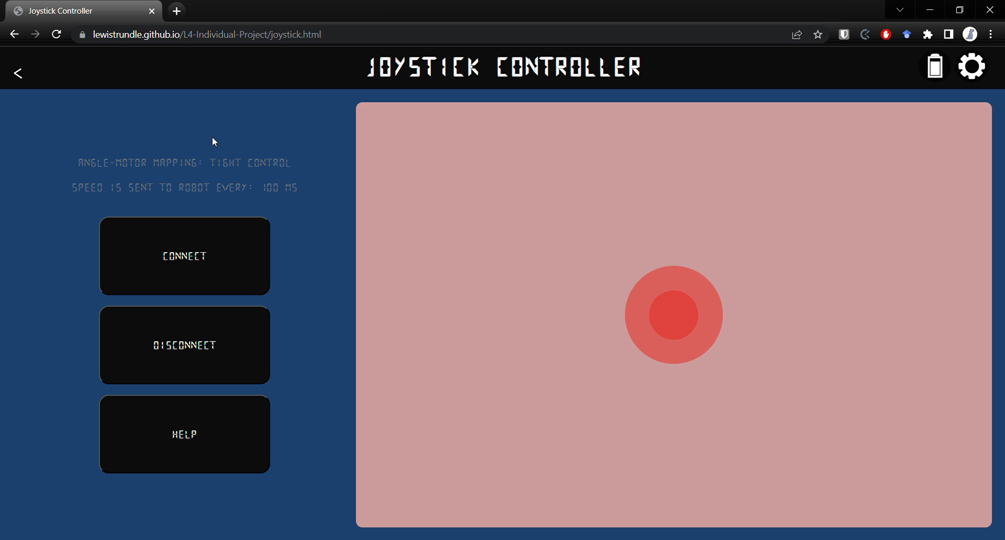
Change Angle-Motor Mapping

Slide 19

Perform Diagnostic

Slide 20

Change Robot Code

Slide 21
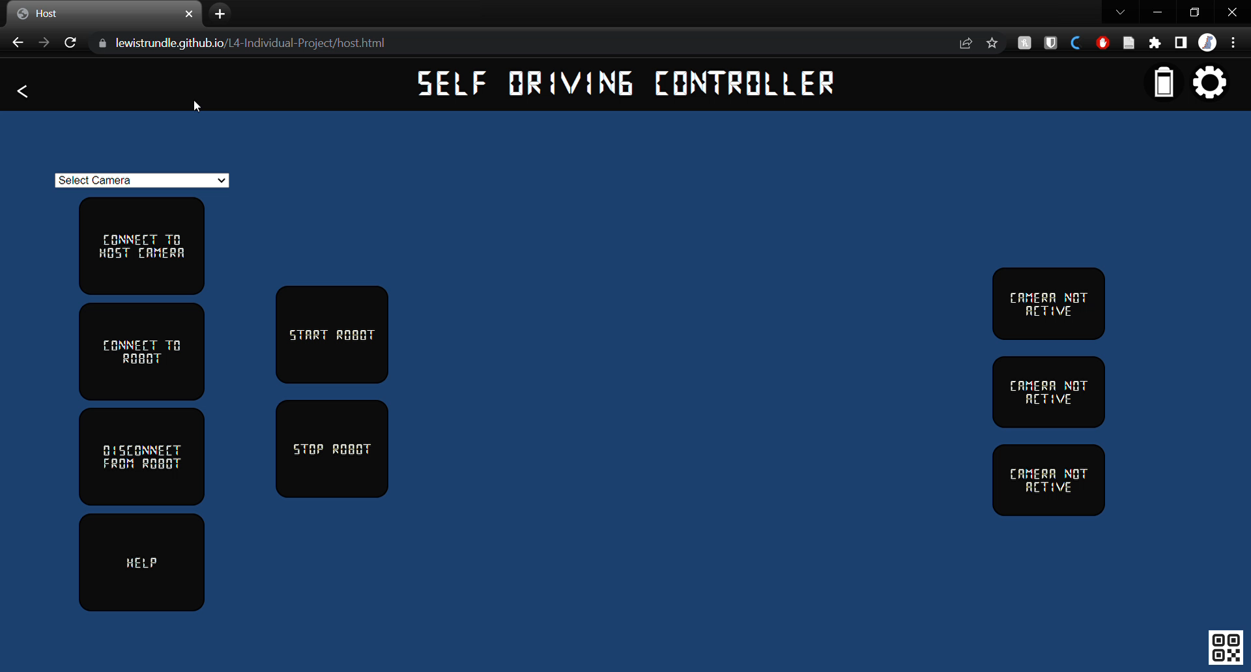
Colour-Tracking Features

Slide 22
Virtual Lead

Slide 23
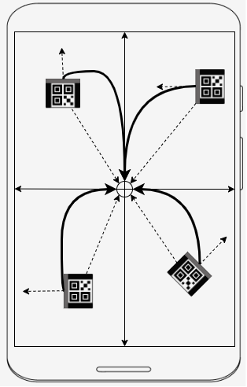
Virtual Lead
Marker is attached to the top of the robot to perform marker detection.
A connected camera is used to guide the robot towards the midpoint of the camera.
This marker allows the robots orientation vector and position vector relative to the midpoint to be calculated.
Angle to turn is the angle between the orientation and position vector.

Slide 24
Virtual Lead Demo

Slide 25
Evaluation and Conclusion

Slide 26
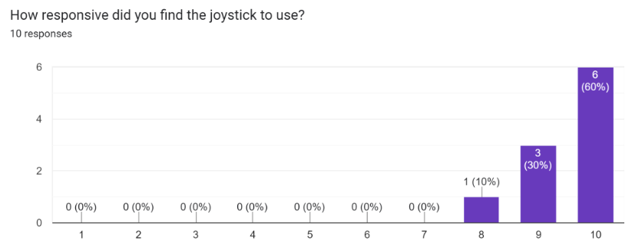
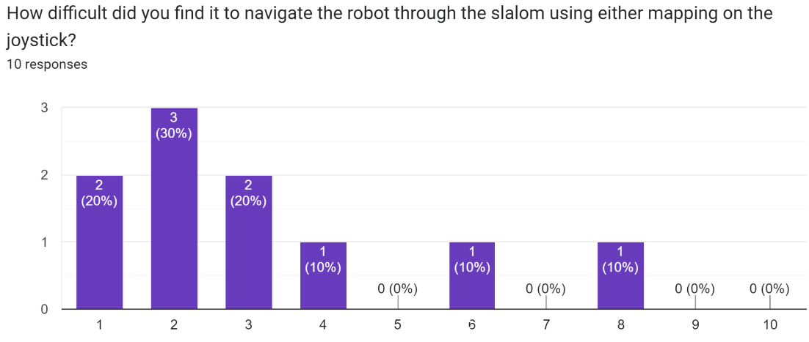
The Joystick
Users enjoyed the joystick!
Could successfully be used to navigate through a slalom.
Participants said it was responsive and easy to use

Slide 27
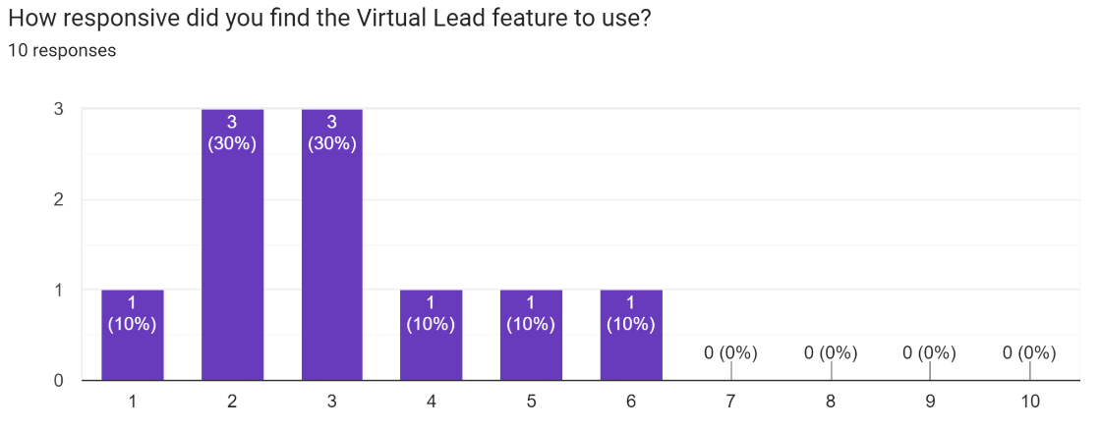
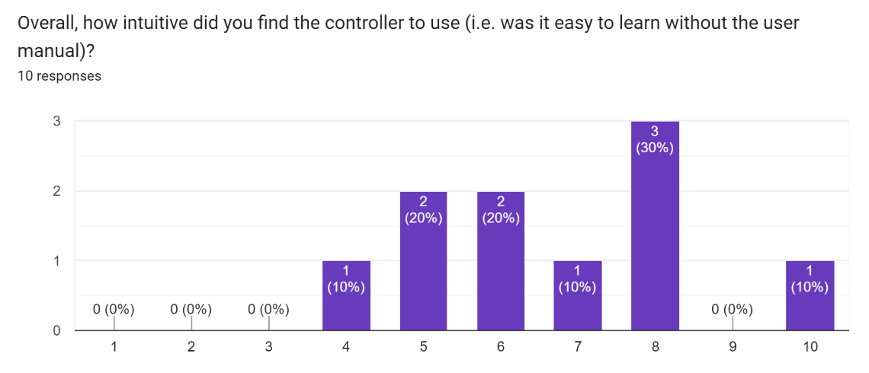
Virtual Lead
Users found it unusable due to poor marker detection.
camera quality, brightness levels, and floor colour and all factors which affected this.
Robot was unresponsive.
Unintuitive to use, requiring a lengthy setup.
Half of participants could not finish.
iOS devices provided better camera quality – hence performed the task better

Slide 28
Future Work
Enhance marker detection using image processing and machine learning techniques
Incorporate sensors to improve navigational ability
Increase overall robustness
And many more

Slide 29
Thank you
Competition Website: https://robot-competition.github.io/robot-competition/
Robot Controller: https://lewistrundle.github.io/L4-Individual-Project/

